Slide 1


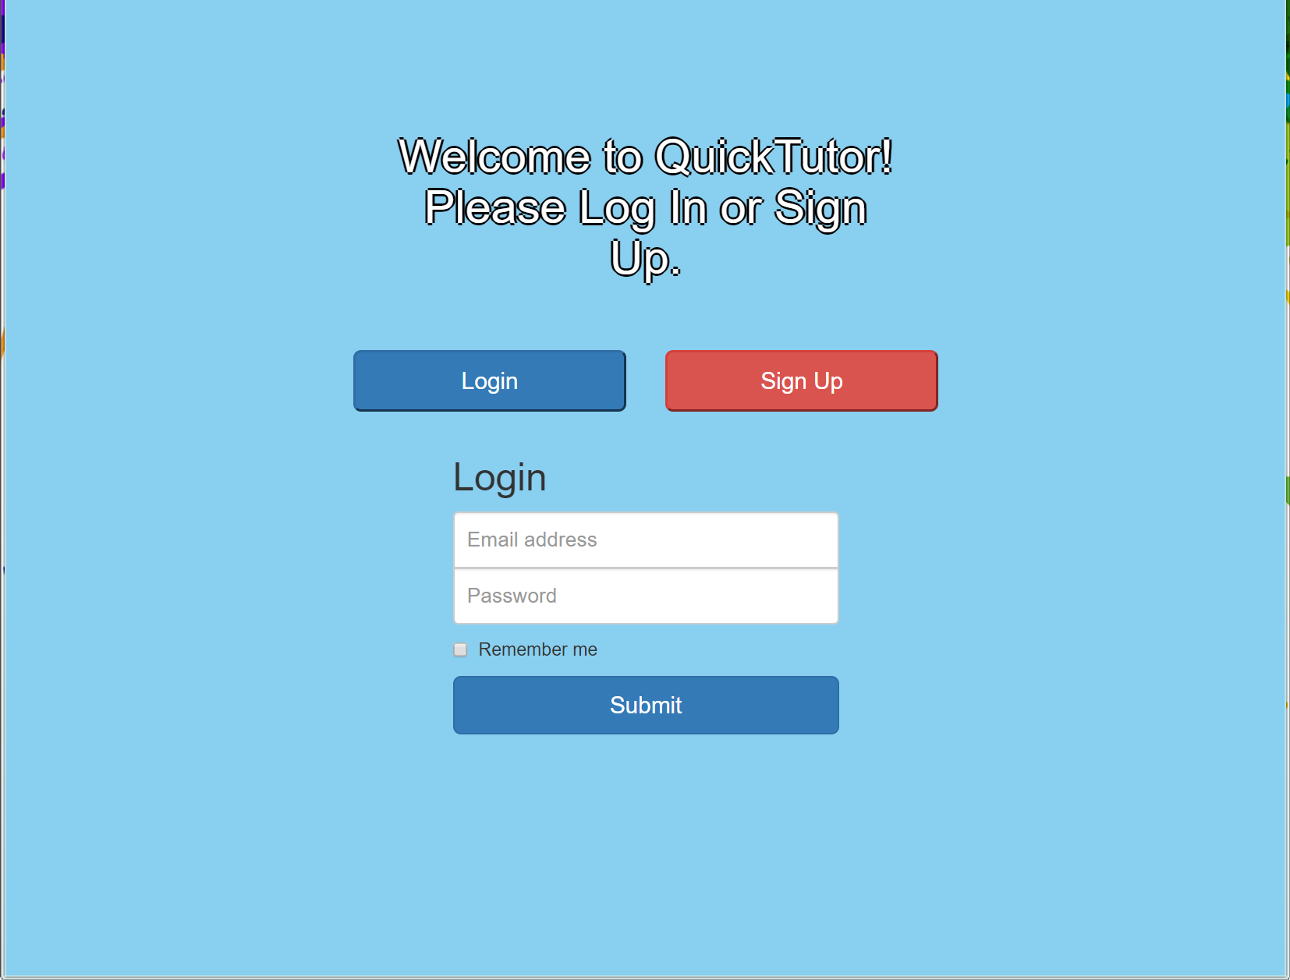
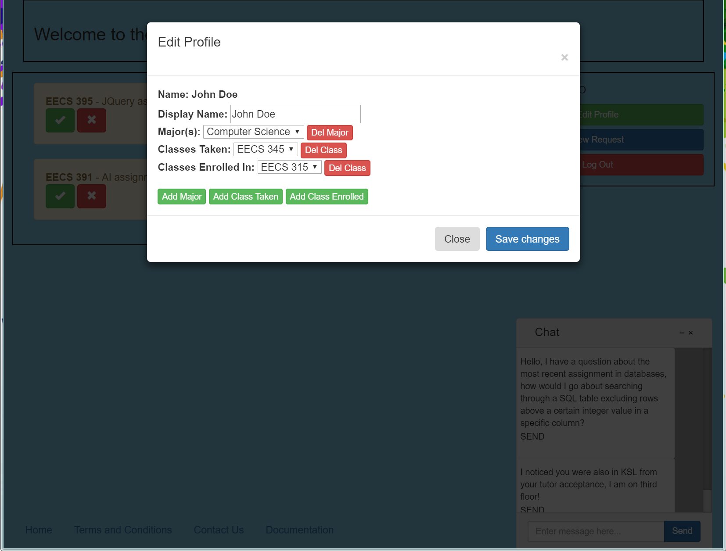
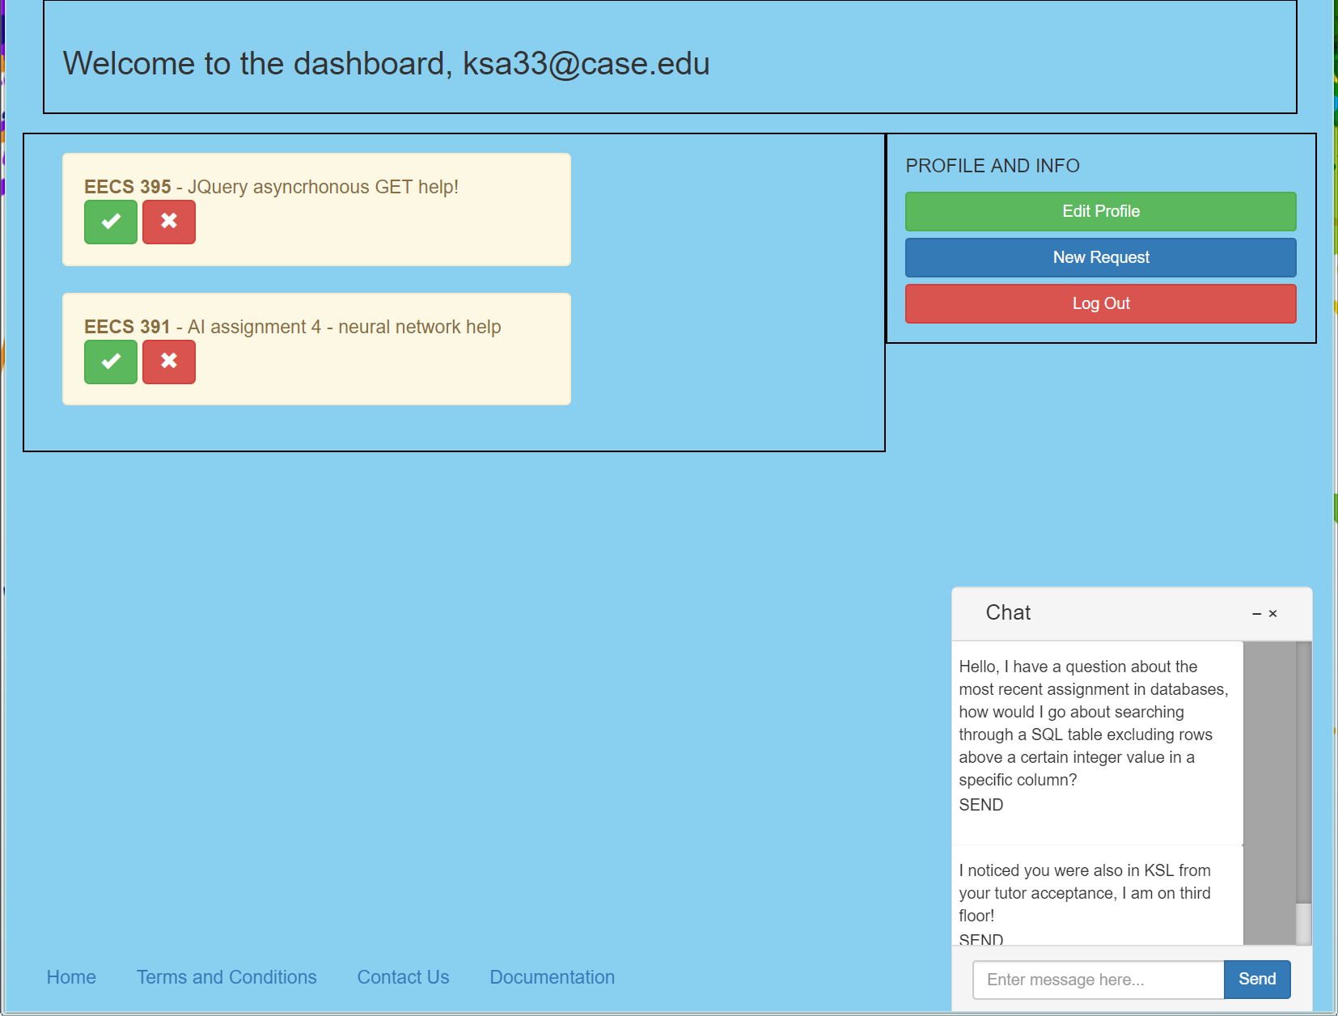
QuickTutor: A Tutoring Application Done Better Through Python
Aditya Malik; Kian Alikhani; Nathan Walls; T. Mammen Kurien
Department of Electrical Engineering and Computer Science
ABSTRACT
FEATURES AND BENEFITS
CHALLENGES AND CONCLUSION
The current tutoring application used by Case Western Reserve University doesn’t offer a quick and easy way to receive help from students. It is difficult to receive immediate help in any subject or topic, and often times there aren’t enough people on the platform to provide students with answers to their problems. QuickTutor aims to solve these issues by creating a simple request-based platform where anyone with a “case.edu” account can submit tutoring requests and receive assistance. QuickTutor is a web-based application that is written in HTML and Python, with the help of Flask based frameworks such as Flask-SocketIO to handle messaging communications. We used Python since it would allow us to develop easily routing pages and also for simple integration with SQLite3. Users will be able to easily post a help request and other students who are logged in to the website can choose to help you right away, either through our chat communication feature or meeting up in person. The application will strictly follow the guidelines listed out by Case Western’s academic integrity policy. QuickTutor will change the way students interact with other students and provide a platform for receiving class aid to everyone.
Compared to the current Tutortrac website from Case Western, QuickTutor has the following benefits:
Wider Tutor Population
Tutortrac approves only certain students to be tutors limiting the number of tutors for numerous upper level classes
QuickTutor allows everyone who has taken a class to be a tutor
University approved tutors will be differentiated to facilitate integration with Tutortrac
Real-time requests
Tutortrac schedules blocks of time (30 minutes) at the tutors convenience, limiting access to students with time conflicts
QuickTutor requests are posted in real time, allowing help during all times of the day
QuickTutor allows students with simple questions to quickly receive help without having to plan in advance and go through a full tutoring session
Integrated Chat Interface
Tutortrac solely provides the tutor’s email as a mode of communication.
Once a tutoring request is accepted by both parties, QuickTutor opens a chat interface for the users to communicate
Challenges
Dynamic Web Development
Seamless Responsive UI for mobile and web clients
Cohesive UI developed by multiple members
Database integration for listings with front end functionality.
Difficulties reproducing problems between machines
Conclusion
Overall, in the brief timeline of this project, we have successfully implemented the majority of what could be a usable service. This is largely thanks to the large amount of resources available today for web development, and the huge market of web development back-end technologies. The large amount of community development on products like Flask allow for seamless implementation of unique features. Using SocketIO for chat is the most extreme example of this, as managing sockets from scratch would have been too difficult to develop in this short period of time. Everyone in the group gained valuable, real-world applicable experience regarding working on a team to deliver a realistic product. We plan to continue building on this project until the end of the semester with hopes of replacing the current Tutortrac platform, or at the very least, providing insight for a better interface.
LIBRARIES
Bootstrap
Powerful HTML and JavaScript library for easily designing the user interface for QuickTutor
Flask Server
HTTP Request/Response routing
Developed in Python, which allows the app to leverage existing python extensions and plugins and Flask-specific extensions created by the community
Handles all of the backend requests for the web application
Flask-SocketIO
Extends base Socket-IO library to utilize Flask functionality
Provides secure p2p communication between clients using the Flask server to route messages
Primarily for instant messaging feature
Flask-Mail
Flask library that provides a mail server to send emails from the server and verify “case.edu” accounts
SQLite
Lightweight SQL database for data storage
Stores user account information, what classes users’ have taken, current tutor requests, and more
Werkzeug
Hashes sensitive information, such as passwords and authentication tokens to provide maximum security to users
REFERENCES
Bootstrap
http://getbootstrap.com/docs/3.3/
Sqlite3
https://docs.python.org/3/library/sqlite3.html
Flask [Flask-Mail, Flask-Flash]
http://flask.pocoo.org/docs/0.12/
Socket-IO
https://socket.io/docs/
Case Western Reserve University’s Schedule of Classes
http://www.case.edu/projects/erpextract/soc.xml
METHOD AND RESPONSIBILITIES
Method
By initially using the Flask backend system, the developers could leverage the powerful python language and many community-made extensions to facilitate development. The SQLite database was created by the backend team while frontend worked on Bootstrap code. Backend then did email verifications and java-form transferring. Finally, Socket-IO was integral in allowing users to communicate quickly and directly with one another using our integrated chat system.
Responsibilities
Kian Alikhani - Front End Development
Developed most of the JavaScript functionality so the front end could leverage backend methods
Integrated Socket-IO with chat system to allow seamless communication between users and tutors
T. Mammen Kurien - Front End Development
Developed the HTML and CSS pages for most of the front end pages, including integration with bootstrap and a few JavaScript functions
Continuously debugged the project, with regards to login errors, database errors and front end integration problems
Aditya Malik - Back End Development
Initializing SQLite database, implementing query functions, transfer java form data between front-end and backend, implement flask flash, organize group meetings and communications, and logo design
Nathan Walls - Back End Development
Collected class information from Case’s resources and formatted it for use in our SQLite database
Developed web service functions for transmitting data between front and back end, storing necessary data in the database
Used Flask-mail to implement account activation upon signup, and a password reset email
Figure 1. Main Login Page
Figure 3. Edit Profile Page
Figure 2. Main Dashboard with Listings and Chat

